Slide 1


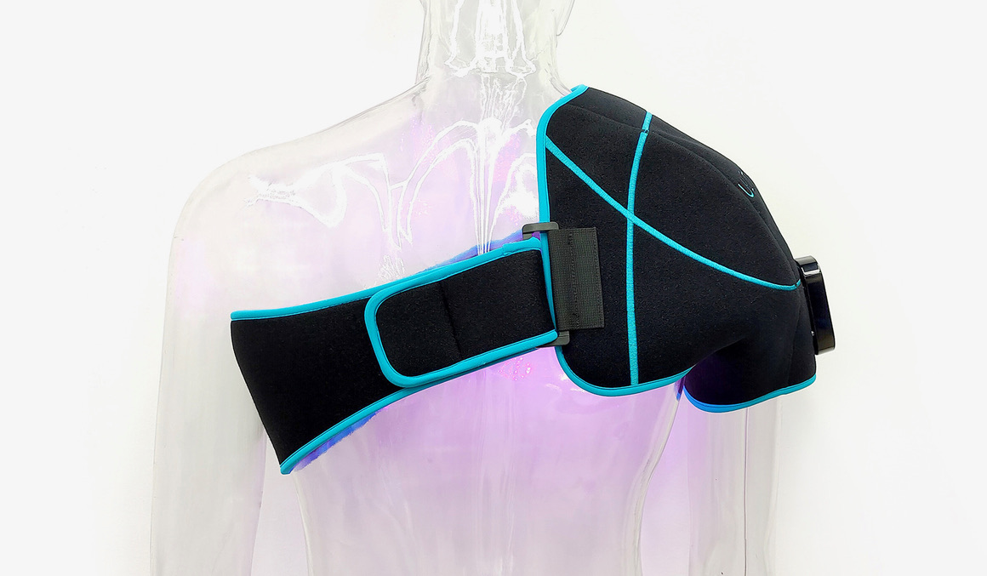
ULTRABEAM
Product benefits. DMG support. Your opportunity.
For experienced VA medical-device representatives
A self-paced product resource
Patient benefits, wearable convenience and DMG behind the scenes
October 2026
DMG / ULTRABEAM distributor training
01
Notes:
This UltraBeam module focuses on product knowledge and first-account preparation. Keep the current Instructions for Use (IFU) available for all device-use questions. The treating clinician determines the treatment plan.
Sources checked 12 October 2026:
https://ultrapainpro.com/wp-content/uploads/2026/07/UltraBEAM-2026-product-spec-sheet.pdf
https://training.dmg.health/assets/04_Product_Training_and_Platform_Walkthrough.pptx
Product photograph supplied by Justin on October 14, 2026: shoulder wrap on demonstration mannequin, preserved original photo 10.jpg. Photo is illustrative; confirm supplied model/controller.

Slide 2
Why carry ULTRABEAM?
Three wavelengths. Wearable light delivery. DMG behind the scenes.
Patient benefit
Low-level LED light therapy for temporary relief of minor muscle and joint pain, spasms and stiffness.
Product fit
Five treatment-area wraps deliver blue, red and near-infrared light in a simple 10-minute routine.
Business support
DMG handles order processing and all fulfillment. You retain the clinical relationships and patient education.
Ready resources
Capability statements, product references and a distributor dashboard keep the essentials available.
DMG / ULTRABEAM distributor training
02
Notes:
Use these outcomes to judge readiness. This module does not confer a clinical credential or establish an independent right to train patients. Ask each participant to name a current account they could use for the practical exercise. Confirm the completion requirements with your DMG onboarding owner.
Sources checked 12 October 2026:
https://training.dmg.health/assets/03_ULTRABEAM_Assessment.docx
https://ultrapainpro.com/wp-content/uploads/2026/07/UltraBEAM-2026-product-spec-sheet.pdf

Slide 3
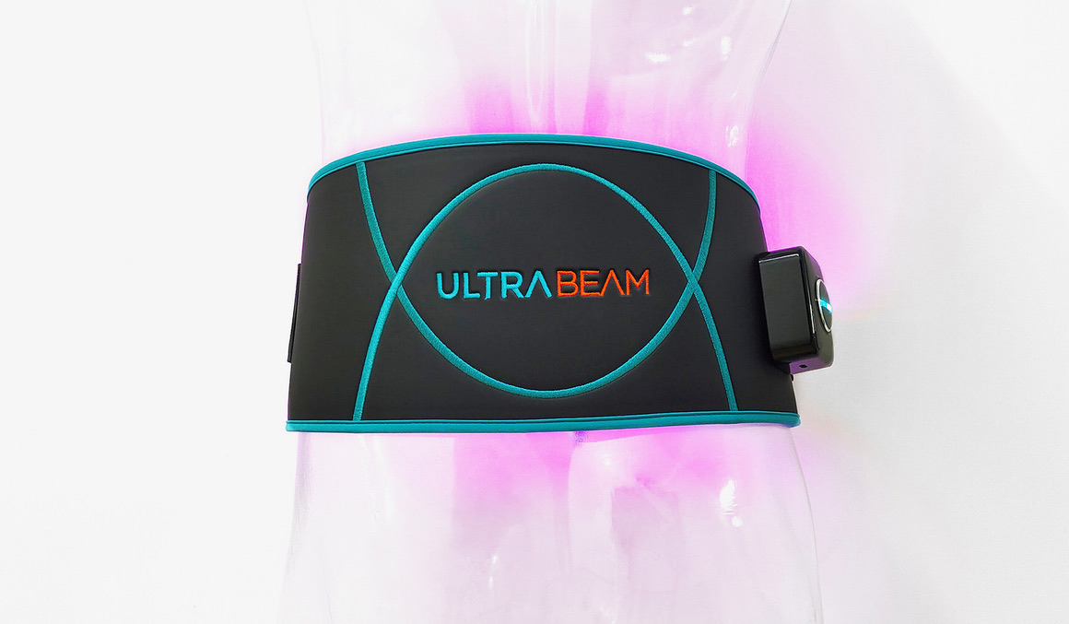
What UltraBeam is
Wearable low-level LED light therapy for home use.
Three light bands
450 nm blue • 650 nm red • 950 nm near-infrared
Pulsed and continuous modes.
Treatment-area choice
Shoulder, cervical, back, knee,
and hand/wrist wraps.
DMG / ULTRABEAM distributor training
03
Notes:
Identify the device before discussing its use. Use the terms in the current manufacturer sheet. The product page describes removable magnetic battery/controller components. Use the current model-specific IFU for controller operation and the current kit documentation to confirm components. The photograph identifies the form factor, not a fitting demonstration.
Sources checked 12 October 2026:
https://ultrapainpro.com/wp-content/uploads/2026/07/UltraBEAM-2026-product-spec-sheet.pdf
https://training.dmg.health/assets/04_Product_Training_and_Platform_Walkthrough.pptx
Product photograph supplied by Justin on October 14, 2026: back wrap on demonstration mannequin, preserved original photo 04.jpg. Photo is illustrative; confirm supplied model/controller.
Supplied UltraBEAM User Manual / Quick Start PDF pp. 2–3: 450/650/950 nm, pulsed and continuous waveforms, no user adjustments. Wraps: p. 8.

Slide 4
Why three wavelengths matter
Different wavelengths interact with tissue differently.
450 nm
650 nm
950 nm
Blue light
Red light
Near-infrared light
Red light reaches living tissue below the skin surface; near-infrared light reaches deeper tissue.
UltraBeam combines all three light bands in the treatment wrap.
DMG / ULTRABEAM distributor training
04
Notes:
The 2026 sheet reports 450, 650, and 950 nm. Technical measurements differ by wrap. Avoid unsupported wavelength-specific healing, antibacterial, or depth claims. The sheet also reports wrap temperatures measured after 10 and 30 minutes. Those are characterization data, not tissue-temperature outcomes and not permission for continuous 30-minute treatment. The treatment schedule comes from page 1.
Sources checked 12 October 2026:
https://ultrapainpro.com/wp-content/uploads/2026/07/UltraBEAM-2026-product-spec-sheet.pdf
Supplied 2026 UltraBEAM Product Spec Sheet p. 2: wavelengths. Ultra Pain Products UltraBEAM product page, sections “3 Light Energies At Work” and research disclaimer, checked 20 October 2026: red light reaches living tissue beneath epidermis; NIR reaches deeper tissue. General light/tissue explanation, not a measured UltraBeam penetration depth or device-specific healing outcome. No blue-light wound/bacteria indication added. https://ultrapainpro.com/ultrabe%CE%BBm/

Slide 5
Light intensity: energy delivered to tissue
A defined light output across each treatment wrap.
21.78–31.65 mW/cm² total light output across the five wraps.
That is light power delivered per square centimeter.
A 10-minute course supplies about 13.07–18.99 J/cm².
60–80 LEDs distribute light across the wrap.
Three wavelengths combine with pulsed and continuous modes.
The controller provides a consistent, automatic 10-minute course.
The wearable design brings multi-wavelength light therapy into a simple home routine.
DMG / ULTRABEAM distributor training
05
Notes:
Suggested language, not a required verbatim script. Adjust the discussion to the clinician’s question while preserving the stated indications and the evidence limitation. Ask what the team needs for an evaluation rather than promising a particular clinical result. If a competing device comes up, request the specific comparison question and obtain a documented, approved response from DMG. Similarity of modality does not establish equivalence or superiority.
Sources checked 12 October 2026:
https://ultrapainpro.com/wp-content/uploads/2026/07/UltraBEAM-2026-product-spec-sheet.pdf
https://ultrapainpro.com/ultrabe%CE%BBm/
https://training.dmg.health/assets/03_ULTRABEAM_Assessment.docx
Supplied 2026 UltraBEAM Product Spec Sheet p. 2, model totals: shoulder 31.65 mW/cm² /18.99 J/cm²; cervical 23.45/14.07; back31.22/18.73; knee28.02/16.81; hand/wrist21.78/13.07. Back60 LEDs; others80. Numeric ranges are descriptive, not proof that higher output gives greater clinical benefit. Manual pp.2–3: waveforms and automatic10-minute course.

Slide 6
The science behind light therapy
Light absorbed by tissue can stimulate cellular responses.
LED light-therapy research explores cellular activity,
circulation, inflammation and tissue repair.
Wavelength, light intensity and exposure time work together
to determine the light energy delivered to tissue.
UltraBeam combines three wavelengths with defined output
and wearable coverage for practical home use.
DMG / ULTRABEAM distributor training
06
Notes:
Source: the current manufacturer product page, disclaimer below the cited research. It states that UltraBeam has not been independently or clinically tested and that the cited studies did not use UltraBeam. Do not use any study percentage as an expected UltraBeam result. General PBM or LLLT research can provide background, but it cannot establish this product’s efficacy. No PainShield study, OnLux result, class-wide response rate, healing claim, medication-reduction claim, or comparative outcome belongs in the product claim set without separate approved evidence. This statement reflects the public manufacturer material checked on 12 October 2026.
Sources checked 12 October 2026:
https://ultrapainpro.com/ultrabe%CE%BBm/
https://training.dmg.health/assets/03_ULTRABEAM_Assessment.docx
General LED-LLLT research context: Kim & Calderhead, Laser Therapy2011;20(3):205–215, doi10.5978/islsm.20.205; supplied manufacturer product page research section. Studies used other devices and treatment parameters; UltraBeam itself has not been independently or clinically tested. This slide explains the technology rationale and does not assign other-device outcome percentages, healing claims or clinical equivalence to UltraBeam. https://pmc.ncbi.nlm.nih.gov/articles/PMC3799034/

Slide 7
Patient benefits
Less discomfort, relaxed muscles and easier movement.
Temporary symptom relief
Minor muscle and joint pain, muscle spasms, and stiffness
Muscle relaxation
Relaxation of muscles and muscle tissue
Local heating and circulation
Raised tissue temperature and a temporary increase in local blood circulation
Hands-free treatment at home, with body-specific wraps and a short daily routine.
DMG / ULTRABEAM distributor training
07
Notes:
The 2026 clinical information sheet is the main source for this slide. Paraphrase conservatively and retain qualifiers such as minor and temporary. Do not expand this into claims that the device heals wounds, treats infection, changes disease structure, reduces medication, or produces a proven postoperative outcome. A clinician determines whether the device is appropriate for an individual patient.
Sources checked 12 October 2026:
https://ultrapainpro.com/wp-content/uploads/2026/07/UltraBEAM-2026-product-spec-sheet.pdf
Supplied 2026 UltraBEAM Clinical Information Sheet p.1: temporary relief of minor muscle/joint pain; muscle spasm relief, muscle relaxation, stiffness relief, temporary local circulation increase. “Easier movement” expresses relief of stiffness, not a measured mobility endpoint.

Slide 8
A wrap for each treatment area
Use this product table as a reference; DMG supplies current quotes and kit details.
Treatment wrap | DMG SKU
Shoulder | LLLTShoulder
Cervical | LLLTCervical
Back | LLLTBack
Knee | LLLTKnee
Hand and wrist | LLLTHandwrist
Capability statements put the wrap, SKU and product information in one place. DMG handles order processing and fulfillment.
DMG / ULTRABEAM distributor training
08
Notes:
These identifiers appear in the supplied DMG UltraBeam product brochure on page 2 and slide 31 of the supplied deck. They are DMG ordering SKUs, not the manufacturer model numbers. The manufacturer’s 2026 sheet corroborates the five wrap types. Confirm current availability, kit contents, prices, contract eligibility, and substitutions before a quote or consult packet.
Sources checked 12 October 2026:
https://training.dmg.health/assets/Ultrabeam_WebEdition_Combined.pdf
https://training.dmg.health/assets/04_Product_Training_and_Platform_Walkthrough.pptx
https://ultrapainpro.com/wp-content/uploads/2026/07/UltraBEAM-2026-product-spec-sheet.pdf
https://training.dmg.health/assets/03_ULTRABEAM_Assessment.docx

Slide 9
Treatment schedule
Manual operating instructions; owner clarification 13 October 2026
10 minutes
3 courses
2 hours
One treatment course
Maximum per area per day
At least two hours between sessions
The controller ends each course automatically.
Multiple treatment areas when applicable. Follow product-specific safety restrictions and clinician guidance.
DMG / ULTRABEAM distributor training
09
Notes:
Sessions last ten minutes, maximum three treatments per treatment area per day, with at least two hours between sessions. Multiple treatment areas may be used when applicable. Follow product-specific safety restrictions and any more restrictive clinician instructions. Manual operating instructions, supplied PDF p. 3 (printed 01), state three treatments per day per treatment area. Justin explicitly clarified on 13 October 2026: “it is three per treatment area per day” (16:57:44 UTC) and “can use multiple treatment areas if applicable” (16:58:00 UTC). This is owner-reported clarification, not an amended manufacturer document. The manual quick-start PDF p. 7 and 2026 sheet p. 1 retain total-daily wording without the per-area qualifier. Preserve that source distinction; do not reopen the already answered scope question. Source: UltraBEAM_User_Manual_Quick_Start_Web_Reading_Copy.pdf. Review-copy correction 20 October 2026; supplied original documents unchanged.

Slide 10
Manufacturer restrictions and precautions
A concern on this list needs clinical review before device-use education proceeds.
Patient factors
Exposure and treatment areas
Light-sensitive skin, including
medication-related light sensitivity
Pregnancy: manufacturer restriction applies
No abdominal use during pregnancy
Do not use on infants or children
Direct light exposure to the eyes
No use over cancerous lesions / tumors
Thyroid gland
Areas of active infection
A cervical wrap still requires placement that avoids the thyroid gland. Manual p. 4: no infants or children.
DMG / ULTRABEAM distributor training
10
Notes:
These six contraindications come from page 1 of the current manufacturer sheet. This slide is a summary, not a complete safety manual. Do not infer suitability from wrap shape. If someone reports a photosensitizing medication, do not improvise a shorter dose or tell them to change medication. Refer the concern to the treating clinician and DMG. Obtain the current IFU for the complete safety and placement instructions before hands-on training.
Review-copy training direction, confirmed by Justin 20 October 2026: no abdominal use during pregnancy and no use over cancerous lesions or tumors. Retain the broader manufacturer pregnancy restriction; do not imply that non-abdominal pregnancy use is cleared. The tumor wording is conservative owner training direction, not a claim that the manufacturer amended its labeling. Manufacturer manual PDF p. 4 uses doctor-consult language; 2026 sheet p. 1 lists pregnancy and treatment over cancerous lesions as contraindications. Supplied source documents are unchanged.
Sources checked 12 October 2026:
https://ultrapainpro.com/wp-content/uploads/2026/07/UltraBEAM-2026-product-spec-sheet.pdf
https://training.dmg.health/assets/03_ULTRABEAM_Assessment.docx

Slide 11
Regulatory language
The 2026 manufacturer sheet identifies the device as an infrared therapeutic heating lamp.
Regulatory classification
Class II, product code ILY, regulation 21 CFR 890.5500
Regulatory pathway
510(k) exempt
Accurate representation
FDA registration or listing alone does not establish approval, clearance, or authorization.
For purchasing questions, provide the current regulatory and product-listing documentation.
DMG / ULTRABEAM distributor training
11
Notes:
Attribute product classification and exemption statements to the current manufacturer sheet. FDA’s Important Reminders page explains that establishment registration and device listing do not denote FDA approval, clearance, or authorization. Do not call the device FDA approved or use FDA branding. Regulatory status does not establish a VA buying decision, a clinical outcome, or the availability of a specific SKU on a particular contract. Confirm product-specific documentation with DMG.
Sources checked 12 October 2026:
https://ultrapainpro.com/wp-content/uploads/2026/07/UltraBEAM-2026-product-spec-sheet.pdf
https://www.fda.gov/medical-devices/device-registration-and-listing/important-reminders-about-registration-and-listing
https://training.dmg.health/assets/03_ULTRABEAM_Assessment.docx

Slide 12
Your role, backed by DMG
The same DMG account workflow for PainShield and ULTRABEAM.
1. Vendor form
Get the correct standard or local form from Prosthetics. Send it to Distributor Support; DMG completes it. You return it and track completion.
2. Capability statements
Deliver the ULTRABEAM capability statement and consult information to Prosthetics and clinicians: correct SKU, Delta Medical, LLC, orders@dmg.health.
3. DMG backend
DMG handles order processing and all fulfillment.
4. Patient education
You handle clinician and patient questions and patient education. Prosthetics equipment questions go to DMG.
DMG / ULTRABEAM distributor training
12
Notes:
This is the workflow taught in the supplied DMG assessment, not a claim that every VA facility uses an identical process. Experienced distributors should map it to their account. Clinical interest alone is insufficient to ship. FSS or SDVOSB positioning may be relevant vendor information but does not guarantee authorization or establish that a particular product is listed. Ask DMG for the current applicable product and contracting documents. Use approved channels for any patient information.
Sources checked 12 October 2026:
https://training.dmg.health/assets/03_ULTRABEAM_Assessment.docx

Slide 13
Vendorization: your four steps
Start with Prosthetics. DMG handles company vendor establishment.
1. Ask Prosthetics
Does this facility use the standard vendor form or a local form?
2. Get the right form
Send the current form to distributorsupport@dmg.health.
3. DMG completes it
DMG completes the company information and paperwork.
4. Follow it through
Return the completed form to Prosthetics and track it through completion with the facility and Distributor Support.
DMG workflow; local requirements vary. Access/badging and clinical or product approval are separate.
DMG / ULTRABEAM distributor training • REVIEW COPY • 13

Slide 14
Account milestones and next step
Keep a named contact, a next action and a follow-up date.
DMG owns
Company registration, vendor establishment and company paperwork. Ask DMG for product and quote documents as needed.
Within 2 weeks
DMG target: identify and complete the local vendorization route; name approval contacts and the next in-service.
Days 45–60
Advance in-services and identify 3–5 prospective patients with clinical contacts.
Your next step
Ask Prosthetics for the correct form. Send it to Distributor Support and track it through completion.
DMG planning targets, not universal VA rules, approval deadlines or patient-volume promises. No patient data in training.
DMG / ULTRABEAM distributor training • REVIEW COPY • 14

Slide 15
Your DMG resources
Business visibility and product support, ready when you need them.
Training resources
DMG Business Management
training.dmg.health
distributor.dmg.health
Current references
Product assessment
Capability statements
Your primary business workspace
Patient Contact Portal: portal.dmg.health
Separate invitation for patient contact
Patient access: authorized contractor signer only for DMG product technical support; no onward access. Synthetic examples for training.
DMG / ULTRABEAM distributor training
15
Notes:
Pivot review: DMG Business Management is primary. Patient Contact Portal is for authorized patient contact only. Rep obtains the current standard or local form from Prosthetics, sends it to Distributor Support, and tracks completion; DMG completes company paperwork. Local access and clinical/product approval remain separate. Use synthetic training only. Product-specific safety and manufacturer qualifications still apply.

Slide 16
DMG behind the scenes
Product resources and backend support for an experienced representative.
Company paperwork
DMG completes the vendor form and returns it within 48 hours. You track it through the facility.
Facility access
DMG covers required access costs. Tell Distributor Support what the facility requires.
Patient and clinician contact
Questions come to you. DMG handles fulfillment and Prosthetics equipment questions.
DMG / ULTRABEAM distributor training
16
Notes:
Facilitator answers: (1) Flag the listed contraindication and refer to the treating clinician and DMG before device-use education. Do not change medication or improvise dose. (2) Explain that the manufacturer’s cited studies used other devices and that this does not establish an UltraBeam response rate. Obtain an approved, device-specific evidence response if one exists. (3) Verify the ordered device and appropriate support materials, refer treatment changes to the care team, and document the concern through the approved process. These cases align with the supplied assessment and are not real patient cases.
Sources checked 12 October 2026:
https://ultrapainpro.com/wp-content/uploads/2026/07/UltraBEAM-2026-product-spec-sheet.pdf
https://ultrapainpro.com/ultrabe%CE%BBm/
https://training.dmg.health/assets/03_ULTRABEAM_Assessment.docx

Slide 17
Product readiness
Know the product and where to find DMG support.
Product references
Find the capability statement, wrap information and current manual.
Patient education
Use the brief safety checkpoint and model-specific instructions.
Product knowledge
Complete the ULTRABEAM assessment.
DMG support
Send your completion summary and product questions to Distributor Support.
DMG / ULTRABEAM distributor training
17
Notes:
Pivot review: DMG Business Management is primary. Patient Contact Portal is for authorized patient contact only. Rep obtains the current standard or local form from Prosthetics, sends it to Distributor Support, and tracks completion; DMG completes company paperwork. Local access and clinical/product approval remain separate. Use synthetic training only. Product-specific safety and manufacturer qualifications still apply.

Slide 18
Patient education and question routing
The rep receives patient and clinician questions; the clinician directs treatment.
Education resources
Use the matching manual and the pre-use checkpoint for the supplied model.
Patient and clinician questions
These come to the representative. Treatment decisions remain with the treating clinician.
Prosthetics equipment questions
These go to DMG. Distributor Support can help with the product or document version.
Distributor support: distributorsupport@dmg.health
DMG / ULTRABEAM distributor training
18
Notes:
Use the current manufacturer IFU for fitting, charging, cleaning, troubleshooting, and stop-use instructions. If a Veteran reports worsening symptoms, the distributor should not adjust treatment independently. For possible device issues, follow DMG’s complaint/adverse-event process. Do not put patient-identifying health information in ordinary email or in this assessment.
Sources checked 12 October 2026:
https://training.dmg.health/assets/03_ULTRABEAM_Assessment.docx
https://ultrapainpro.com/wp-content/uploads/2026/07/UltraBEAM-2026-product-spec-sheet.pdf
https://training.dmg.health/assets/Ultrabeam_WebEdition_Combined.pdf

Slide 19
Product reference shelf
Current sources for product detail and patient education.
Manufacturer manual / quick start and 2026 sheet
Supplied UltraBEAM User Manual / Quick Start (8 PDF pages); 2026 clinical/specification sheet (2 pages).
Manufacturer ULTRABEAM product page
Product description, design context and research qualification.
DMG product list
DMG wrap SKUs and ordering identifiers.
ULTRABEAM distributor assessment
Product knowledge and DMG onboarding reference.
FDA registration and listing reminder
Registration and listing do not establish approval, clearance, or authorization.
DMG / ULTRABEAM distributor training
19
Notes:
Use the manufacturer’s current clinical and specification sheet for product facts. DMG’s product list supplies the ordering SKU mapping. The assessment provides the practical exercises. Ask DMG for the current model-specific IFU and any additional approved evidence needed for a provider question.
Sources checked 12 October 2026:
https://ultrapainpro.com/wp-content/uploads/2026/07/UltraBEAM-2026-product-spec-sheet.pdf
https://ultrapainpro.com/ultrabe%CE%BBm/
https://training.dmg.health/assets/Ultrabeam_WebEdition_Combined.pdf
https://training.dmg.health/assets/03_ULTRABEAM_Assessment.docx
https://www.fda.gov/medical-devices/device-registration-and-listing/important-reminders-about-registration-and-listing
https://ultrapainpro.com/resources/

Slide 20
Use the supplied manual for practical support
Do not substitute a slide or product sheet for the model-specific instructions.
Before first use
Manual p. 3 (printed 01): light-sensitivity test on the forearm for 3 minutes; check for redness lasting more than 2 hours.
If sensitive / uncomfortable
Manual: discontinue for sensitivity; stop and contact Customer Service for overheating or uncomfortable heat. Route medical questions to the doctor.
Setup and care
Charge fully (2–4 hours); secure the pad directly on skin. Turn off and unplug before cleaning; allow the pad to dry completely.
Adapter / safety boundaries
Use only the supplied adapter. No abdominal use during pregnancy; no use over cancerous lesions/tumors. Retain the broader manufacturer pregnancy restriction.
Source: supplied User Manual PDF pp. 2–5 and 7; 2026 product sheet pp. 1–2. Full warnings still apply.
DMG / ULTRABEAM distributor training • REVIEW COPY • 20

